Slide 1

Spreadsheet Alternatives and Tips
David Webb
DNJ Solutions
June 2009

Slide 2
Introduction
Excel or Calc
What is Included
Uses of Spreadsheets
Some Less Obvious Uses
Design
Specific Functions - Excel
Comparison to Open Office Calc

Slide 3


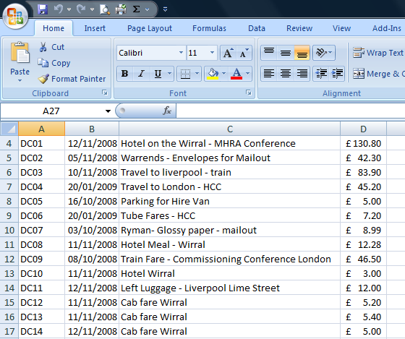
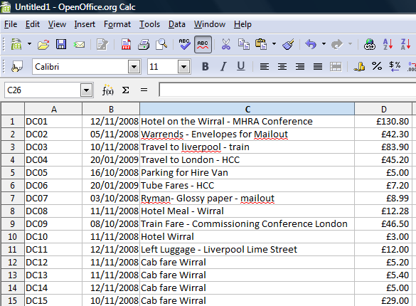
Excel or Calc
http://download.openoffice.org/

Slide 4
Comparable Functions
Office Excel 2007
Open Office Calc 2.4 – looks like ....
Office Excel 2003
And now there is Open Office Calc 3.1
And there are some other products
  Google Apps
  iPhone Apps
  Excel Mobile

Slide 5
What Can you use a Spreadsheet for?
Cash analysis
Summations
Graphs
Average Values
Maximum and Minimum Values
Sales Ledger
Monitoring Productivity

Slide 6
But also some different reasons
Mailshots - data organisation
Data lists – can be linked to Access Databases
Sorting information
Filtering
Scheduling
Project Management
Asset register

Slide 7
Thoughts About Design
Is it just for you?
  You need to be organised
  But as long as you know what you have done when you go back and revisit it later
Is someone else going to use the sheet?
  You need to be more organised
  Your design needs to take account of the person who is going to be using the spreadsheet

Slide 8
Specific Examples
Average
Absolute Values
Subtotal
If
Data Validation
CountIf
Conditional formatting

Slide 9
Average
You have a series of Values – say customer invoices and you want to know the average value of them
Invoice Number | Value
347 | £ 650.00
348 | £ 809.00
349 | £ 140.00
350 | £ 651.00
351 | £ 44.00
352 | £ 609.00
353 | £ 546.00
354 | £ 456.00
355 | £ 349.00
356 | £ 809.00
357 | £ 578.00
Total Value | £ 5,641.00
Average Value | £ 512.82
Maximum Value | £ 809.00
Minimum Value | £ 44.00

Slide 10
Absolute Values
This is really useful if you have one value which you need to assign to a number of fields. If you just copy a formula it assumes you want to continue the string you have started.
Use of the $ symbol locks this set value
Also useful in What If Modelling, it avoids you needing to keep typing the same value in.

Slide 11
SubTotal
Really useful when used in coordination with sorting.
You can determine the subtotal of a category within an overall list.
You can take this a step further by taking combinations of categories
In practice you may use something like this.

Slide 12
If Statements
These are very useful for overcoming troublesome formulas
If you set a value by formula and you do not want a negative answer, an if statement will allow you to return a zero value rather than a negative one.
Here is an example where our widget guys earn 10% commission on sales above £775.

Slide 13
Data Validation
Sometimes you need to allow data to be restricted to certain ranges
You can specify and upper limit
You can specify a lower limit
You can assign a note to the cell
You can custom an error message when ineligible data is entered.

Slide 14
Count and CountIf
Count – adds up the number of cells which contain a number. Can be used in conjunction with If
CountIf – this function allows you to count how many entries in a range are of a certain type of text – for example how many orders were received by email
A third option is DCOUNT which gives data within a range of criteria

Slide 15
Conditional Formatting
It is visually helpful to colour code some lists- for example
  We may wish to look at records for a certain customer
  We may wish to identify orders over £400 in value
  We can colour scale our values from the smallest (red) to the largest (green)
  Or we can highlight fields that contain a value

Slide 16
And What About Open Office
Most of these functions are available in Open Office Calc
Conditional formatting is lost if you import from Excel.
It does work but you will need to start from scratch using the Format ..... Conditional Formatting

Slide 17
And Finally ...
Thanks for coming
Thanks for listening
Any Questions:
David Webb
DNJ Solutions
david.webb@dnjsolutions.co.uk
www.dnjsolutions.co.uk

